Slide 1
AI-Assistant Development Project (prompt Engineering & Web Assistant) (MAJOR PROJECT) Presented by: Samriddhi Kathane

Slide 2
Project Overview
Goal: Develop a multi-functional AI Assistant.
Core functions:
Answer Questions
Summarize Text
Generate Creative Content
Interface: Simple, web-based, with feedback system.

Slide 3
Problem Statement & Motivation
Problem: Users rely on multiple tools for information, summarization, and creativity.
Motivation: One integrated assistant improves efficiency, supports learners, and simplifies workflows.

Slide 4
Project Objectives
Develop three distinct assistant functions.
Create multiple tailored prompt templates.
Implement a user-friendly web interface.
Integrate a feedback mechanism.
Ensure complete documentation and usability.

Slide 5
Scope & Requirements
Functional Scope:
Q&A responses
Text summarization
Creative text generation
Non-Functional Scope:
Simple and responsive interface
Feedback storage
Basic API key security

Slide 6

System Architecture
User → Web Interface → Flask Backend → OpenAI API → Output → Feedback Storage
Components:
Frontend: HTML, CSS, JavaScript
Backend: Flask (Python)
AI Engine: OpenAI API
Data Logging: Local JSON/File

Slide 7
Technology Stack & Tools
Languages: Python, HTML, CSS, JavaScript
Frameworks & Libraries: Flask, OpenAI SDK, python-dotenv
Development Tools: VS Code, GitHub
Environment: Localhost (with deployment options)

Slide 8
Core Features
Q&A: Provides concise, factual answers.
Summarization: Generates both short and extended summaries.
Creative Writing: Produces stories, poems, and ideas.

Slide 9
Example Prompts
Q&A: “What is the capital of France?” / “List three facts about Paris.”
Summarization: “Summarize this in 2 sentences: [TEXT]” / “Extract main points.”
Creative Writing: “Write a short poem about rain.” / “Outline a sci-fi story on time travel.”

Slide 10
User Interface
Input form for queries or text.
Function selection options.
Output display area.
Feedback option for quality review.

Slide 11
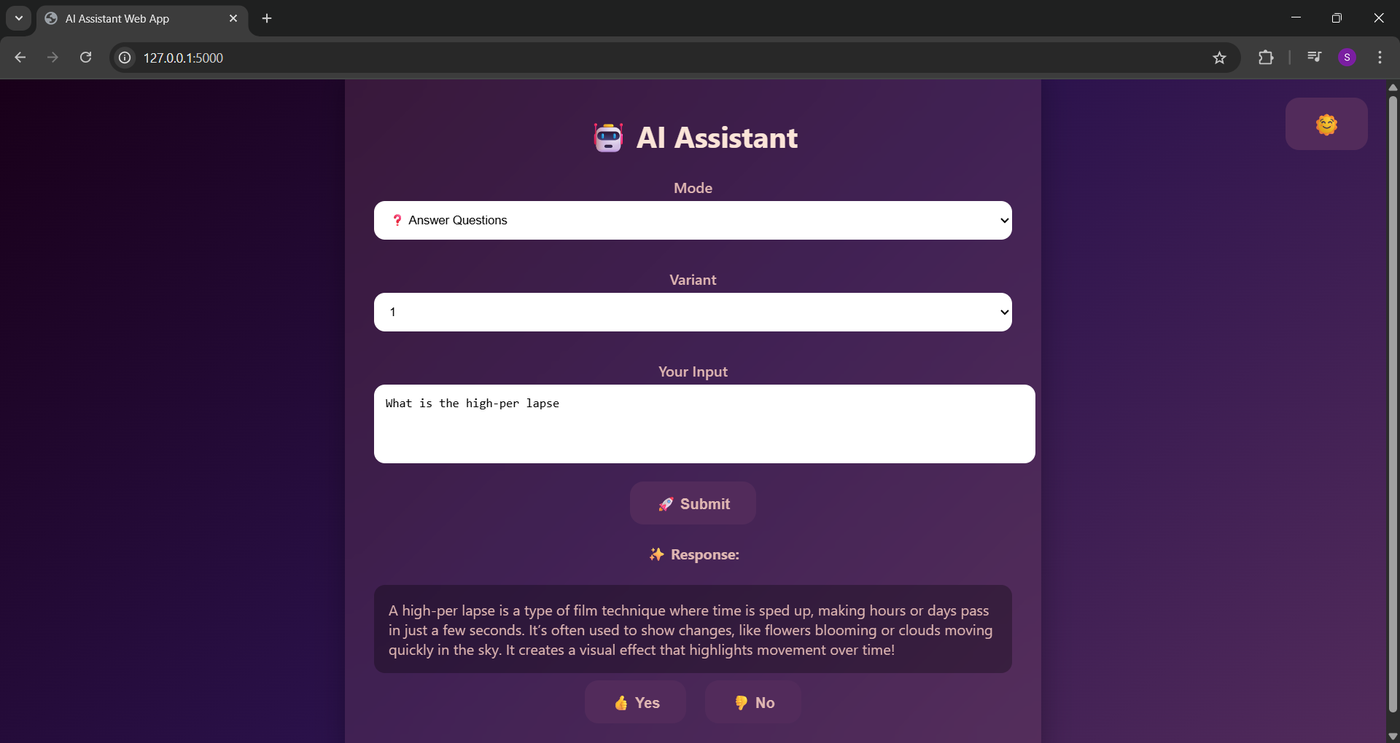
User Interface (continued)

Slide 12
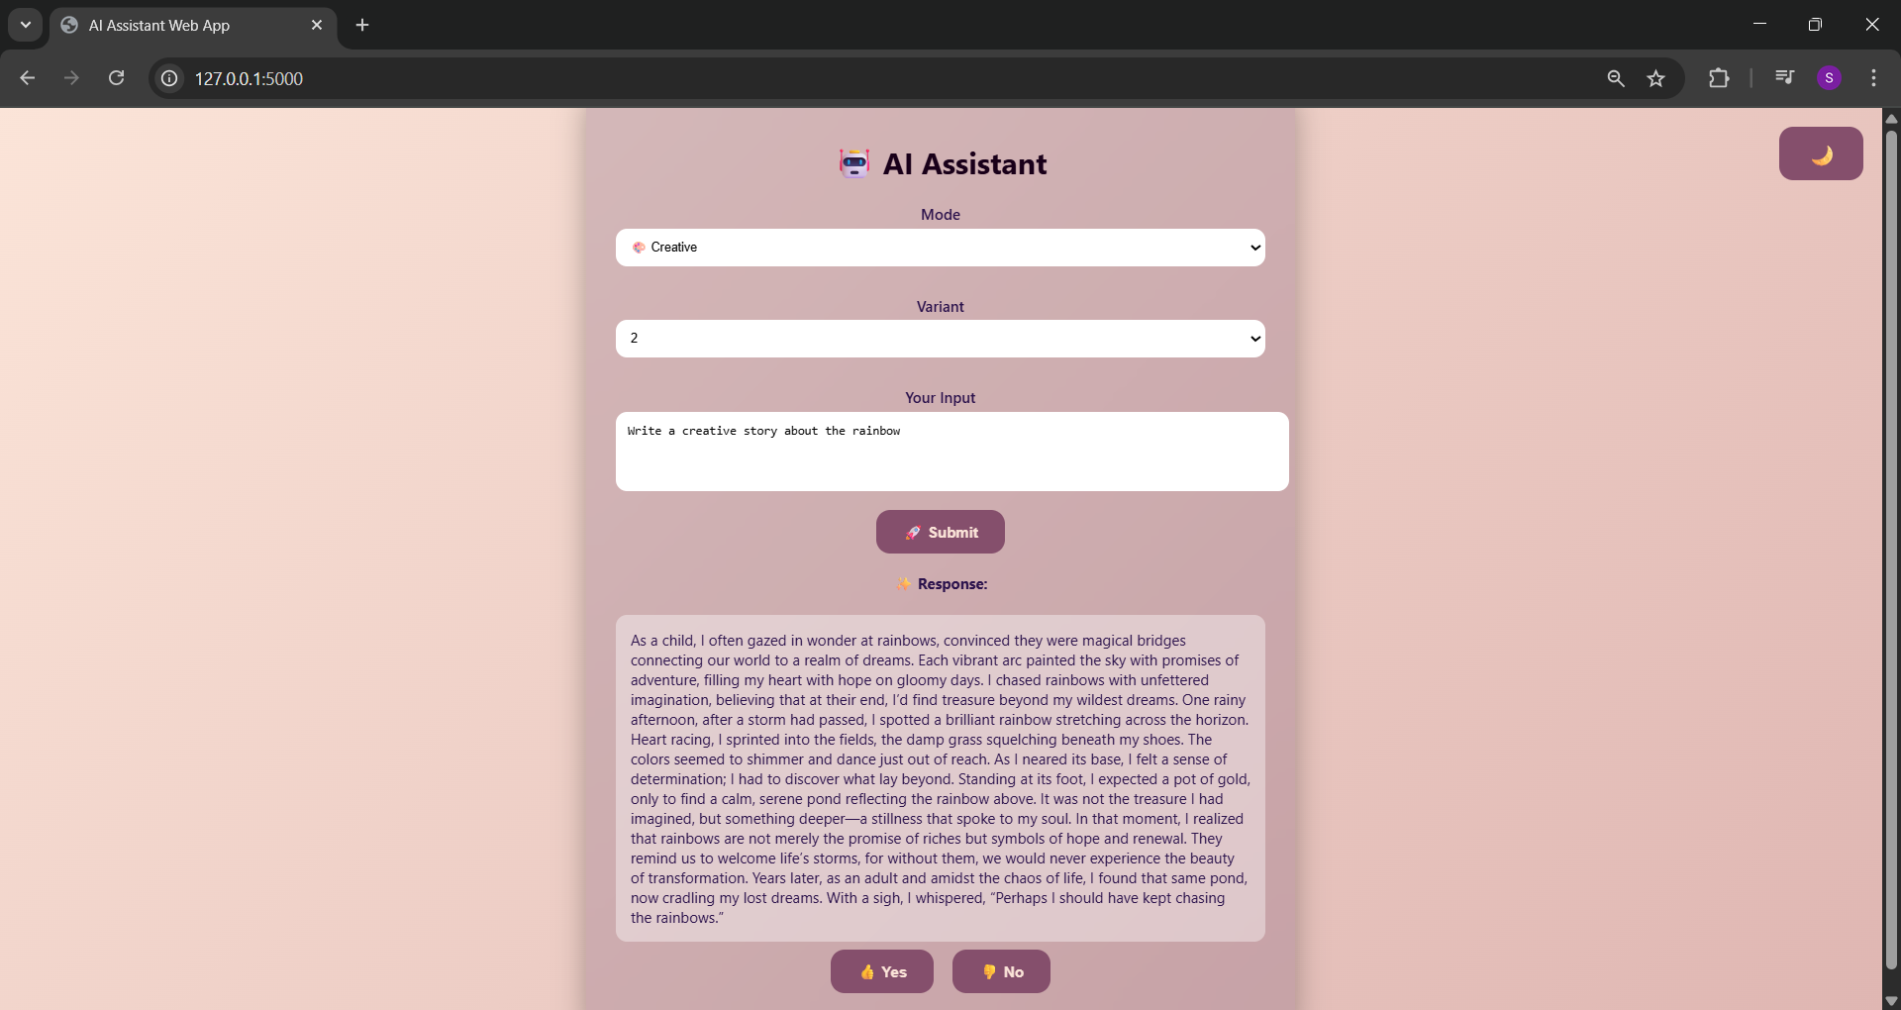
User Interface (continued)

Slide 13
Implementation Details
File Structure (Current Project):
app.py — Main Flask application
app_cli.py — Command-line interface for testing
prompts.py — Stores prompt templates
feedback/ — Folder or file to log user feedback
templates/ — HTML templates for UI
static/ — (CSS/JS if added)
.env — Stores API keys securely
requirements.txt — Dependencies list
venv/ — Virtual environment folder
__pycache__/ — Auto-generated cache files
test_env — Test environment or configuration file

Slide 14
Setup & Running the Project
Open Project in VS Code → File → Open Folder → select folder with app.py
Open Terminal → New Terminal → Confirm path.
Activate Virtual Environment:
.\venv\Scripts\activate
Install Packages:
python –m pip install –upgrade pip
python –m pip install flask python- dotenv openai
Verify Installation:
python –m pip show flask
python –m pip show python-dotenv

Slide 15
Setup & Running the Project (continued)
Run App:
python app.py
Access via: http://127.0.0.1:5000/ (by clicking on this given address)
Save Dependencies:
python –m pip freeze > requirements.txt
Reinstall later using:
pip install –r requirements.txt

Slide 16
User Manual (End-User Guide)
Steps for Users:
Access via: http://127.0.0.1:5000/ (by clicking on this given address) or Open browser → Visit http://127.0.0.1:5000/
Select a function: Q&A, Summarize, or Creative.
Enter input text or question.
Click Submit.
Review generated output.
Provide feedback.

Slide 17
User Manual (End-User Guide) (continued)
Examples:
Input: What is the capital of France? → Output: Paris.
Input: Paste text → Output: Concise summary.
Input: Write a poem on rain → Output: Generated poem.
Notes:
Requires internet access.
No technical expertise needed once running.

Slide 18
Testing & Evaluation
Manual test cases and edge case handling.
Assessment Criteria:
Correctness of responses
Relevance of summaries
Creativity in generated text
Feedback satisfaction levels

Slide 19
Challenges & Solutions
Unreliable outputs → Refined prompts.
Delays in responses → Optimized context length.
API key management → Used .env file
Handling invalid inputs → Added validation checks.

Slide 20
Limitations & Future Work
Current Limitations:
Prototype stage
Dependency on OpenAI API
Future Enhancements:
Multi-lingual capabilities
Voice interaction
Mobile app support
Persistent memory integration

Slide 21
Conclusion
Achieved functional AI Assistant with 3 core features.
Highlighted the importance of iterative prompt engineering.
Delivered a working prototype with practical applications.
Key takeaway: Prompt refinement significantly enhances outputs.

Slide 22
Thank you

